Slide 1


Building the rest of the form for more functionality
Pieter Pypers, Turry Ouma

Slide 2
A few tips for the ‘name’ column:
When making up a variable name try to be both concise and descriptive.
Avoid any variable name that begins with any special character or number or which contains any spaces in between. These will be flagged as errors by ODK Validate.
The “name” column allows up to 32 characters but in order to anticipate data analysis with other statistical packages, limit the length of the variable names to 12.
Consider using the «camelCase» when writing variable names and avoid underscores («_») since some statistical packages read underscores as blanks.
All “begin group” types must have a corresponding “end group”.

Slide 3
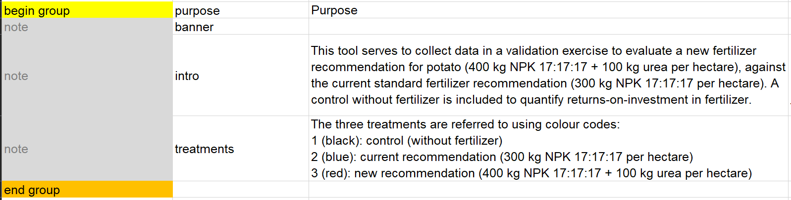
Let’s piece together the rest of the form!
Groups
Groups are used to put together related questions for data export and analysis. In our instance we have put together some notes to explain the purpose of the survey as seen below:
In the example, Notes are used to provide additional information and instructions to the user while not taking any input.
It is important to note that ‘end group’ doesn't require a name or label, as it will not be visible in the form. However, if groups don’t have an end group they will cause an error when uploading the form. Always ensure that each begin group has an end group.

Slide 4
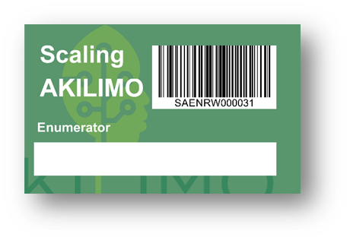
User information
You need to record on which participating household you will collect data. You can use a barcode on an ID card.
See below how to include barcode question type to help collect user information in the ODK form
Next you also need to always make sure where the data is being collected. We recommend that you always, at the start of the form, record the GPS location using geopoint.

Slide 5
‘MyCap’ Data Collection Tool
For the next exercise we will build an XLSForm called ‘MyCapTool’.
This is an example of a data collection in an on-station 3-factorial experiment, where the plot information is read from a csv file using the pull data function.
The information includes the plot identifier (repNr and plotNr) and the levels of the 3 factors in an RCBD with randomized plot numbers within rep.
What does the pull data function do?
For a predefined set of data in csv format like in our case the treatMyCap.csv. If you wanted to be able to pull this information into the form you are going to use in the field you can apply this function.

Slide 6
Building the XLSForm
We start off by putting in place the now familiar metadata and then a note to introduce the purpose of the survey.
After this we form a group to specify the replicate number and to allow selection of parameters that will be used to collect data. All these are key variables to be used in the repeat group.
In order to determine the number of iterations, we include an integer type question to capture the number of plants on which canopy measurements will be taken. We provide relevant constraints; the number has to be more than or equal to 5. Note the relevant section which dictates that this repeat group is only applicable if the user selects the parameter ‘CM’.

Slide 7
Now let’s pre-load some values!
The first thing we do is capture the plot number then add a calculate data type which combines (concatenates) the replicate number and plot number to form the lookupKey.
NextUnder calculation column see how we call the pulldata() function e.g. for strain: pulldata('treatMyCap', 'strain', 'lookupKey', ${lookupKey}). Let’s break this down:
'treatMyCap': the csv file from which we are pulling data from.
'strain': the column that we want the data pulled from
'lookupKey': the column that acts as a key in the external csv files
${lookupKey}: the field in our tool that should match the key for each field that we want pre-loaded into our tool we add a calculate data type and give an appropriate field name.

Slide 8
In summary…
In summary, we are pulling the value from the ‘strain’ column of the treatMyCap’ csv file, using the lookupKey field in our form to link to the specific row in the csv file’s lookupKey column.
Now you can use the newly created ‘pull data fields’ in other fields in the survey; see line 19. You can also use the fields in the constraint, relevant columns etc by calling it using the $ sign as any other field in the survey.

Slide 9
Downloading data from Ona for analysis
There are two ways of getting data from Ona:
1. Export the data directly from ona in the Overview tab:
Click on ‘Prepare Data Export’
Select file type as .csv
Under ‘Advanced export options’ you can select applicable choices
Click Export CSV file
Proceed to download
2. Using ODK Briefcase

